Slide 1
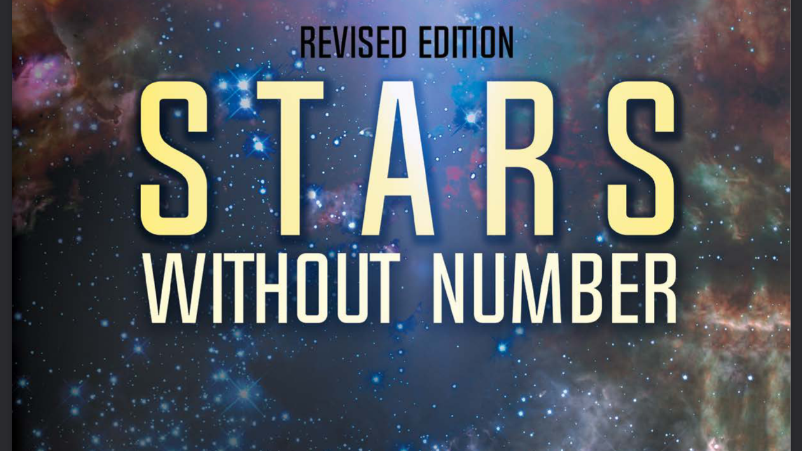
Character Creation Tool
Dominic Cousins
Notes:
Welcome
My project is built around Stars Without Number (SWN), a tabletop RPG
And it was to build a tool that assists in character creation for SWN

Slide 2
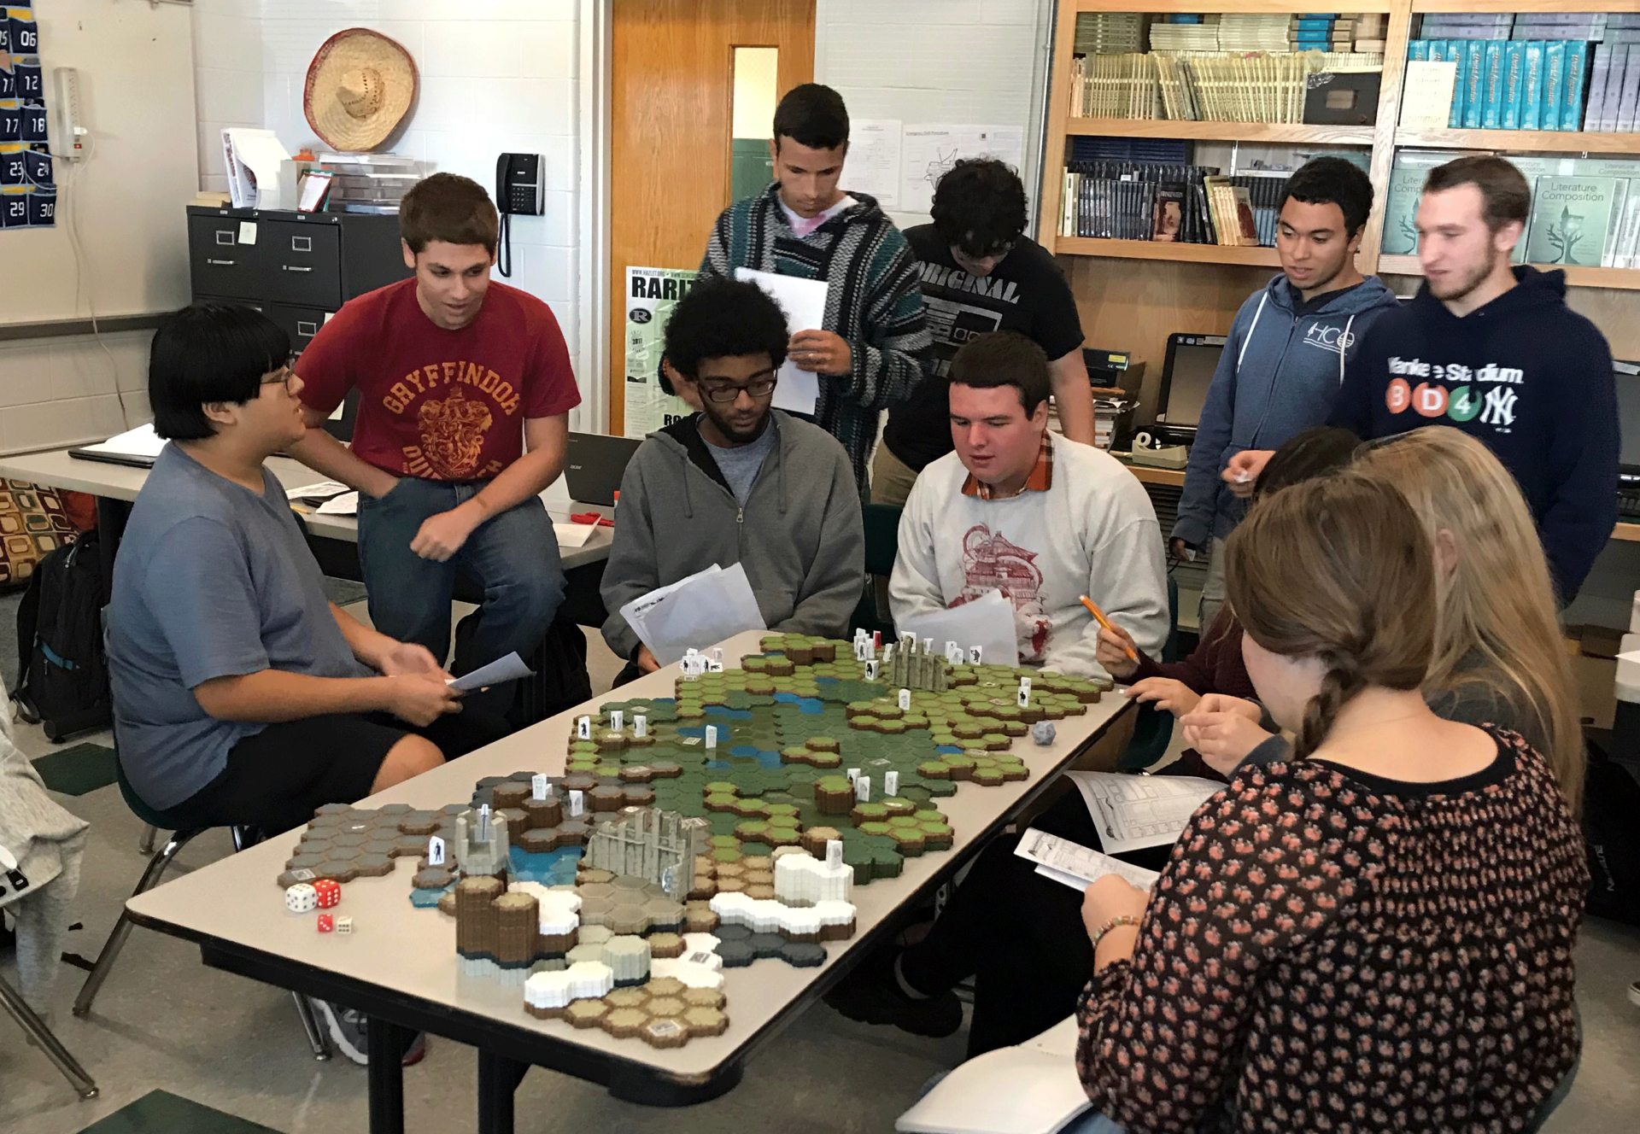
What is a tabletop RPG?
A game of improvisation
Follows/crafts a narrative
Players navigate a map
Involves combat and non-combat encounters
Players grow their character with gear and levels
Powered by a character sheet
Notes:
Some background – what is a tabletop RPG, or Role-Playing Game
A game about improvising, acting, playing a character of your design in a fantasy world
Over several game sessions the game master (GM) creates a narrative and tells a story
Players navigate a map, small scale with figurines, large scale with a map, or even purely narrated
The players might get into fights, or conversations, or encounter puzzles, and by resolving these encounters they progress the story
Across game sessions the players keep the same characters which they develop, gaining levels and skills, or gold and gear
It’s powered by the rulebook (all 300 pages of it) and character sheets which are stores of information about players characters

Slide 3
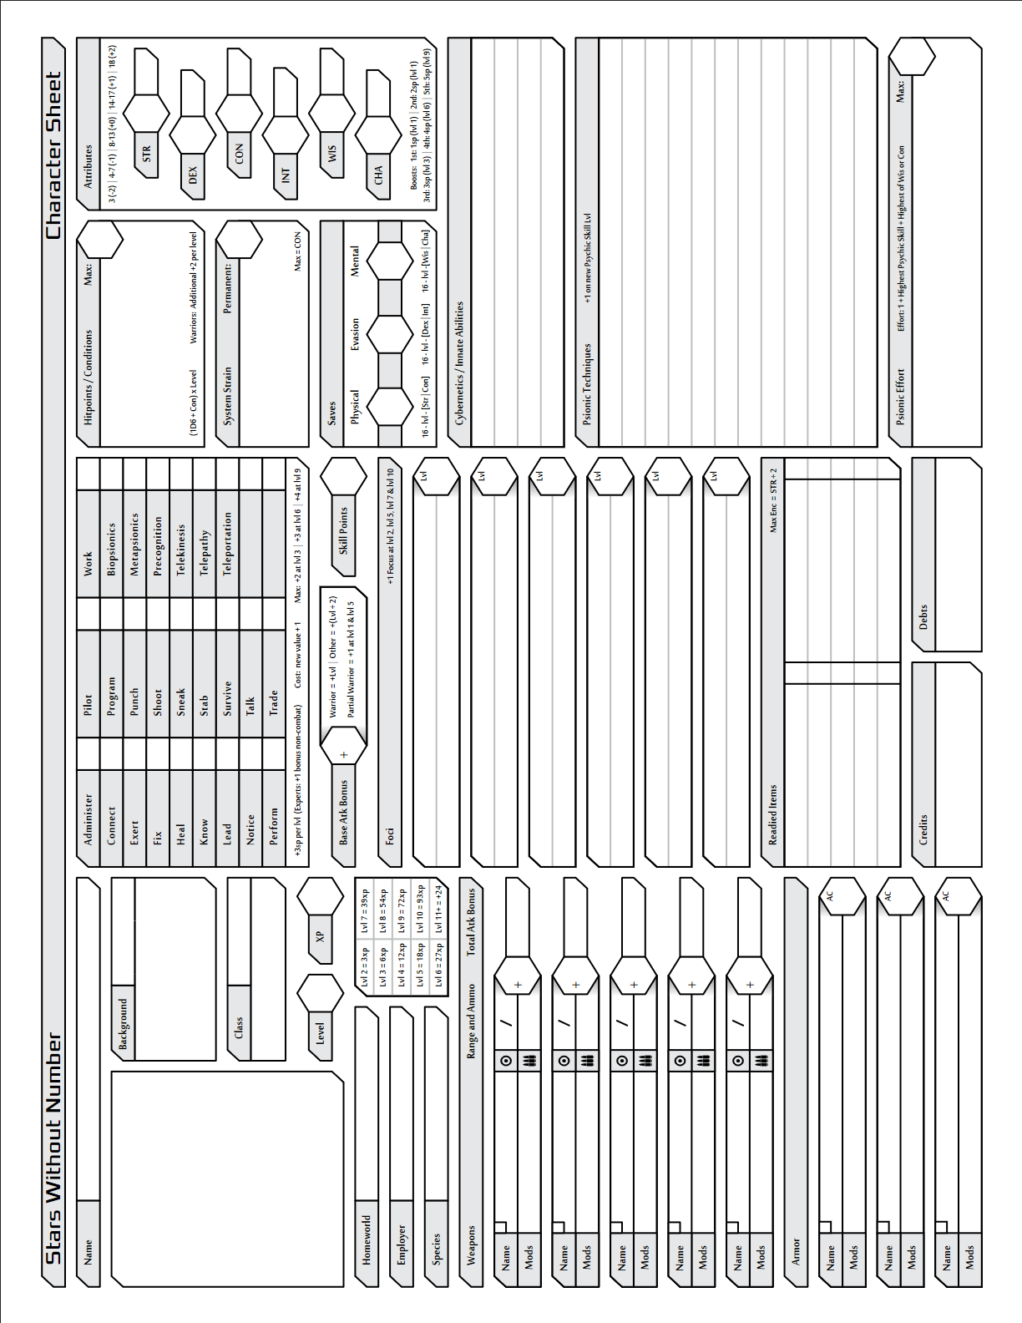
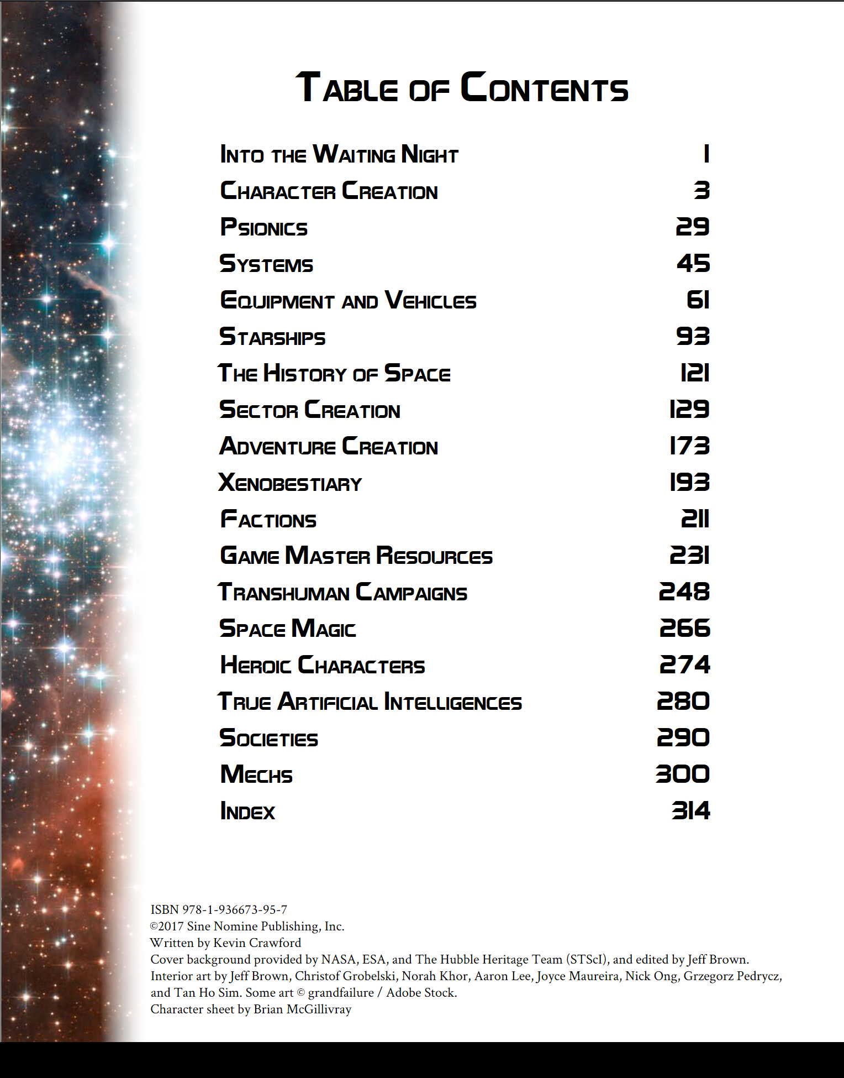
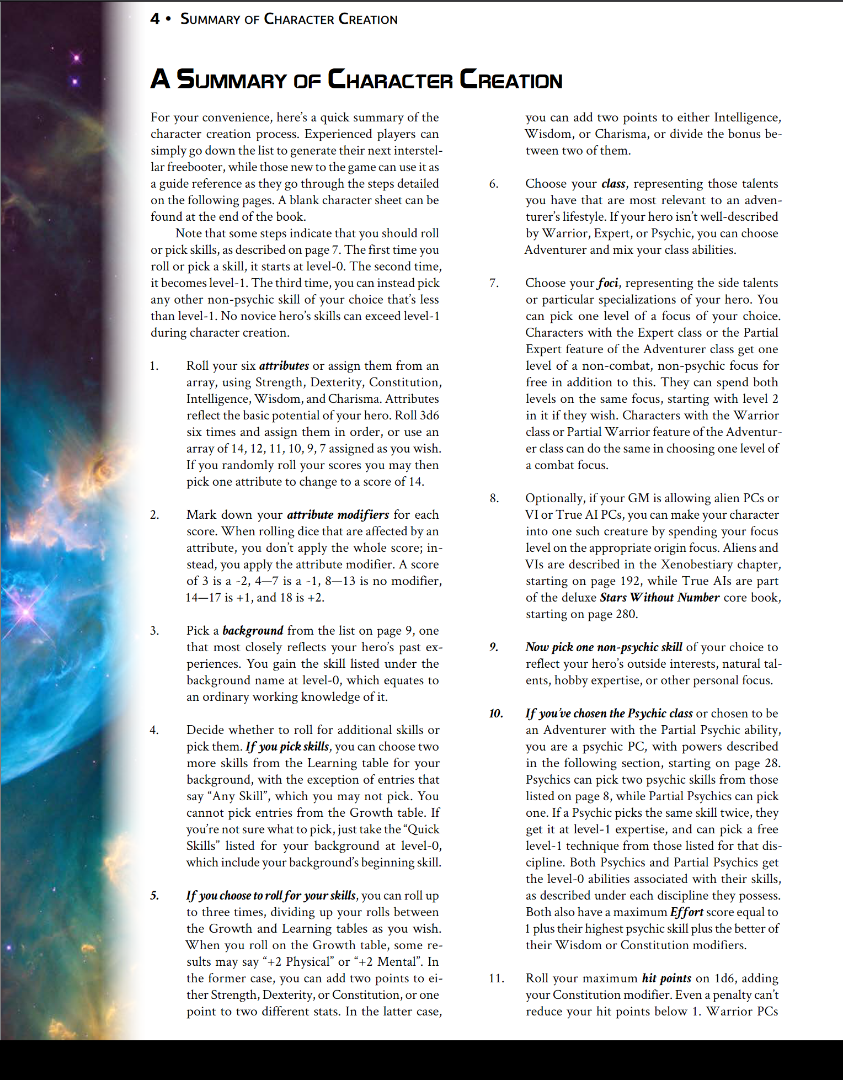
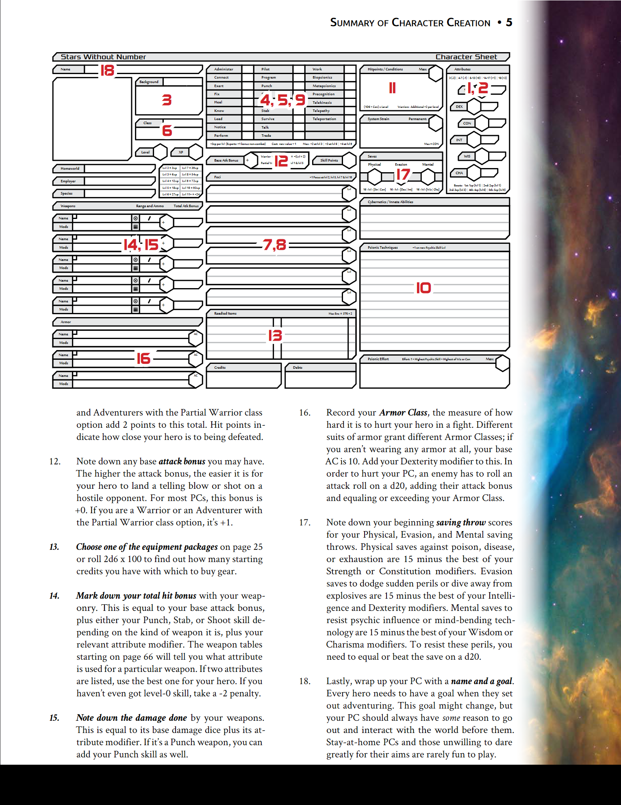
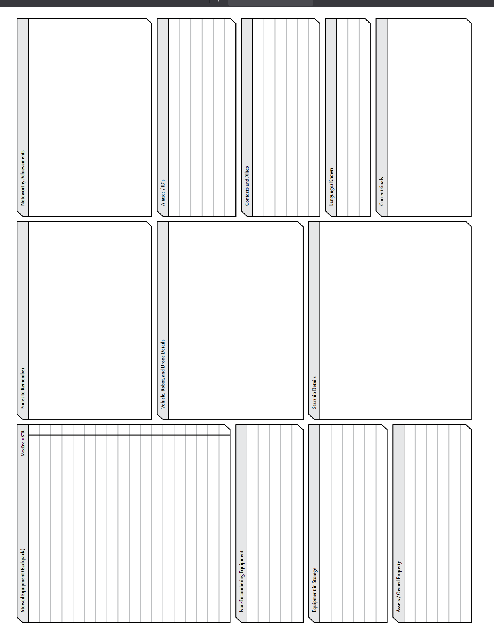


Notes:
This is the summary of character creation taken straight from the rulebook
You don’t need to read all of this but I just wanted to show you how large the procedure is
Here we have 18 numbered steps across 2 pages, and most steps will involve referring to other sections of the rules so it can look quite intimidating
(click)
This is the table of contents just to show how much of the rulebook is referenced by character creation alone
Over 25 pages on the process alone!
Another 15 if you are a psionic.
Another 30 of just lists and descriptions of equipment that you’d need to refer to.
And finally another 10 if your character is an Artificial Intelligence
(click)
Here’s a blank copy of a character sheet that this whole process would result in you filling in, traditionally with a pencil on physical paper.

Slide 4

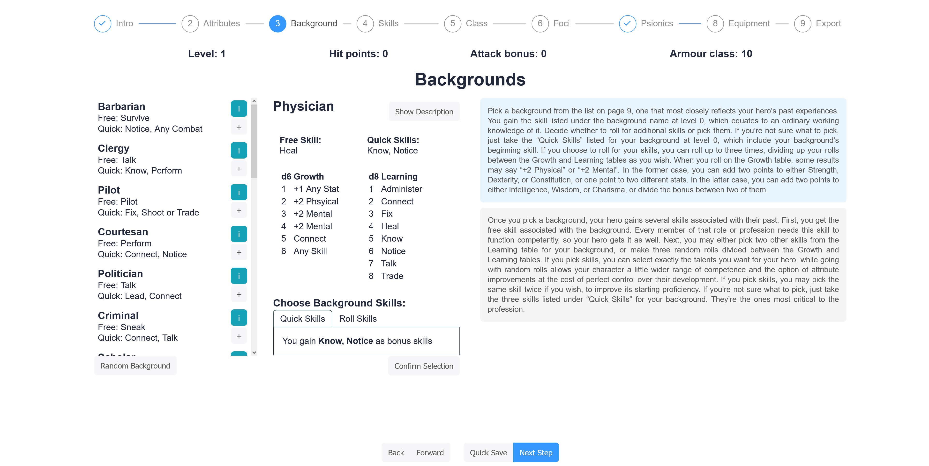
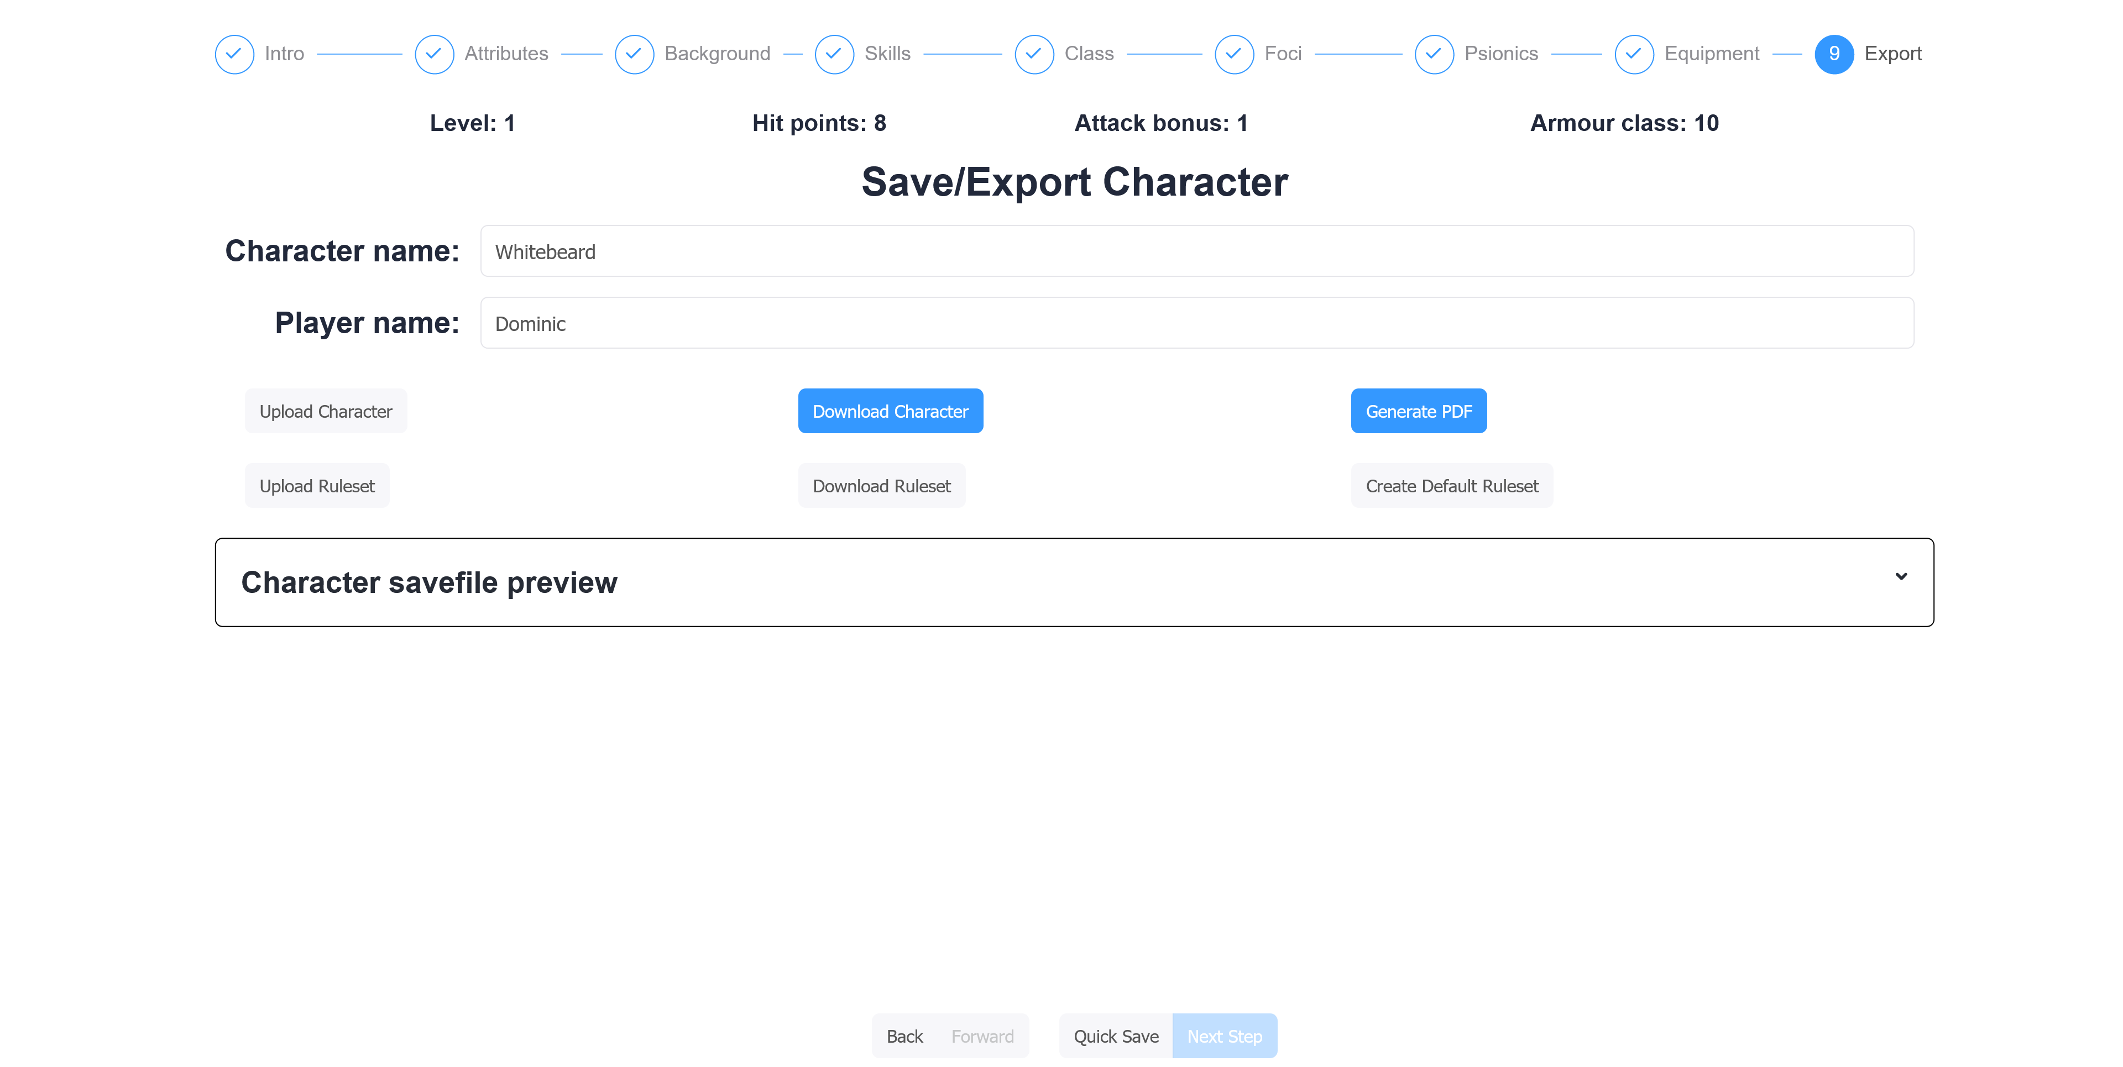
Notes:
My project created a tool that removes all that faf, replacing the steps in the rulebook with 9 panels, including an intro and export options
Instead of following all the text I showed previously and constantly looking at different sections of the rulebook, it is condensed into 7 interactive panels that each display all the information you would otherwise be scouring the rulebook for
This is the backgrounds panel for example, it lets you choose your characters background and the finer aspects of it
The other panels indicated at the top are similar to this one, and users simply proceed through them with the next step button
(click)
Until they reach the final panel where they can save and export their resulting character

Slide 5
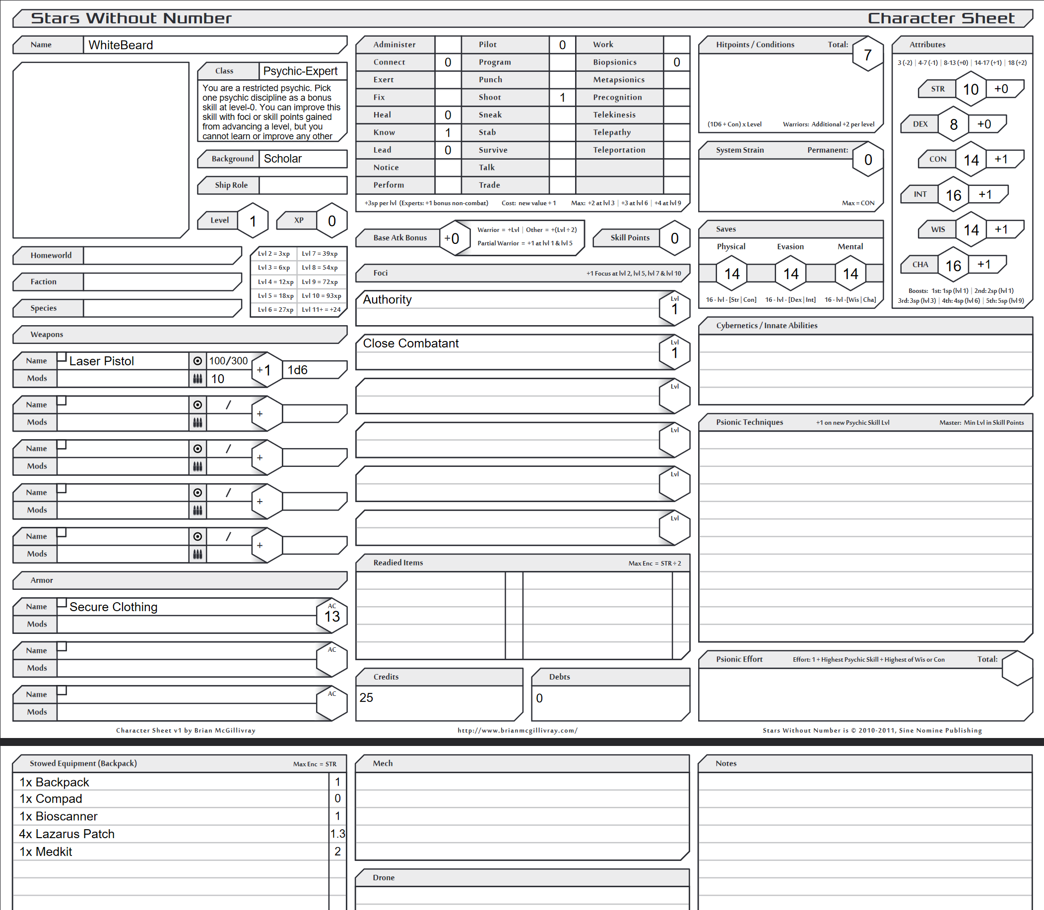
Tool Overview and Output
The tool minimizes steps to create a character
Uses interactive panels to replace reading large rules and using the book to lookup items
Outputs a character sheet PDF for printing as if you had spent all the time filling it in by hand
The sheet describes the character based on users picks and has all calculated values filled in
Easier to make changes vs pencil and eraser
Notes:
The tool reduces the number of steps users must follow to make a character (down to 7 from 18)
Using interactive panels makes the process much simpler, and users can have a fully guided experience by using the next step button
Outputs a character sheet PDF for printing as if you had filled it in traditionally, but is much less tedious compared to doing it by hand
The outputted sheet describes the players character based on their decisions made within each panel, and automatically fills in any calculated values such as the saves
When a character sheet becomes quite old, it shows a lot of marks from being filled in a rubbed out over and over. By using a digital version, and maybe printing big new versions, it reduces all the pain that comes with making changes to your character

Slide 6
Project Objectives
Create and populate a database to store data on game objects such as skills, weapons, and player classes
Host a web server that can connect to the database and serve requests for objects from the database via a REST API
Write a webapp that guides players through the process of creating a character, and outputs a character sheet from it
Develop JSON format to store game rules enabling users to upload customised versions of the rules for the tool to abide by
Create an algorithm to suggest choices that could be made at each step of character creation, to further aid newer players

Slide 7
Product Objectives
Enable more players to play Stars Without Number by reducing the complexity of character creation process - more like 10 minutes, less like 2 hours
Make the whole process more fun, and less tedious
Give players digital access to information about entities in the game, such as player backgrounds
Fill a gap in the market as there is no tool that fulfils these aims, and stimulate the community by releasing the source code

Slide 8
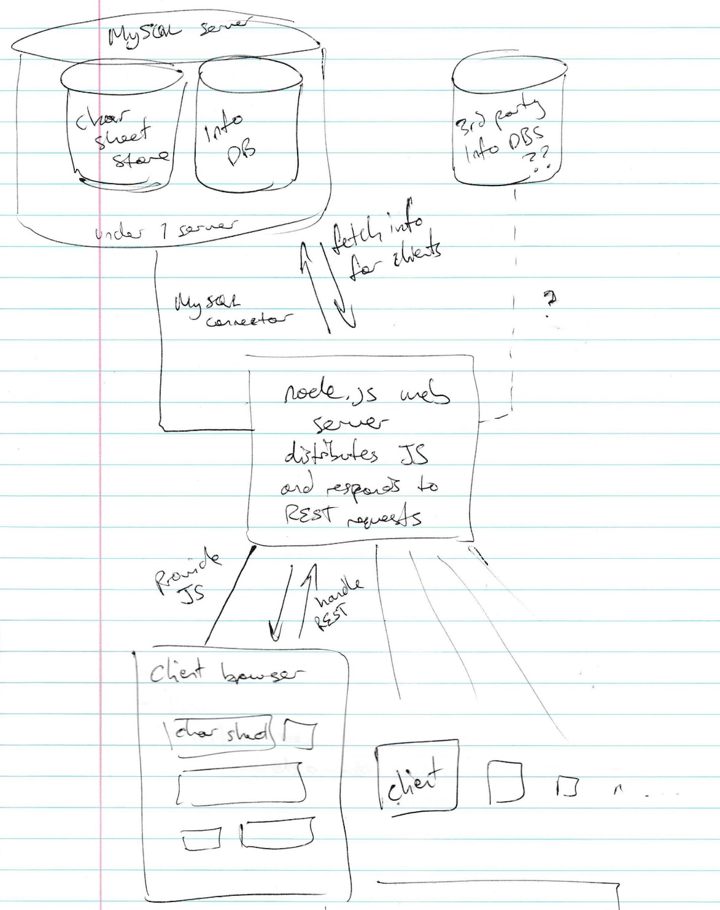
Project Architecture
MySQL database as data store
Contains lists of all objects available in the game and data about them
Stores users’ saved characters and ruleset customizations if they wish
Node.js server and REST API
Distributes the client to web browsers as a base HTML page and minified JavaScript
Serves unauthenticated requests for game object data via a REST API
React.js-based client
All app functionality handled by client-side JavaScript
UI generated by JavaScript via React.js library
Uses REST API to fetch data about game objects

